Slide 1
File Systems
  Some slides and/or pictures are adapted from
  Operating System Concepts, 9th edition, by Silberschatz, Galvin, Gagne, John Wiley & Sons, 2013
  Lecture notes by Dr. Prof. John Kubiatowicz (Berkeley)

Slide 2
File Systems
What is a file system?
  A method for storing and accessing files
We’ll concentrate on:
  User interface to files
    Naming, access
  System representation of and access to files
    Structure, protection
  Translation between user and system views

Slide 3
File System Components
Disk Management
  How to arrange collection of disk blocks into files
Naming
  User gives file name, not track 50, platter 5, etc
Protection
  Keep information secure
Reliability/durability
  When system crashes, lost stuff in memory, but want files to be durable

Slide 4
Long-term Information Storage
Must store large amounts of data
Information stored must survive the termination of the process using it
Multiple processes must be able to access the information concurrently

Slide 5
Characteristics of Secondary Storage
Large amounts
  TB
Slow to access
  Milliseconds
It’s free
  Not quite, but close
It’s there
  Hangs around for a long time

Slide 6
User vs. System View of a File
System View of a file | User’s View of a File
Block oriented, may be scattered | Byte or record oriented, contiguous
Physical block #’s | Name files
No protection | Users protected from each other
Data might be corrupted if machine crashes | Robust to machine failures

Slide 7


Translating from User to System View
File
System
What happens if user says: give me bytes 2—12?
  Fetch block corresponding to those bytes
  Return just the correct portion of the block
What about: write bytes 2—12?
  Fetch block
  Modify portion
  Write out Block
Everything inside File System is in whole size blocks
  For example, getc(), putc() ⇒ buffers something like 4096 bytes, even if interface is one byte at a time
From now on, file is a collection of blocks

Slide 8
File Operations (User Interface)
Create
Delete
Open
Close
Read
Write
Append
Seek
  Change current offset
Get attributes
Set Attributes
  Modifications times, protection bits
Rename

Slide 9
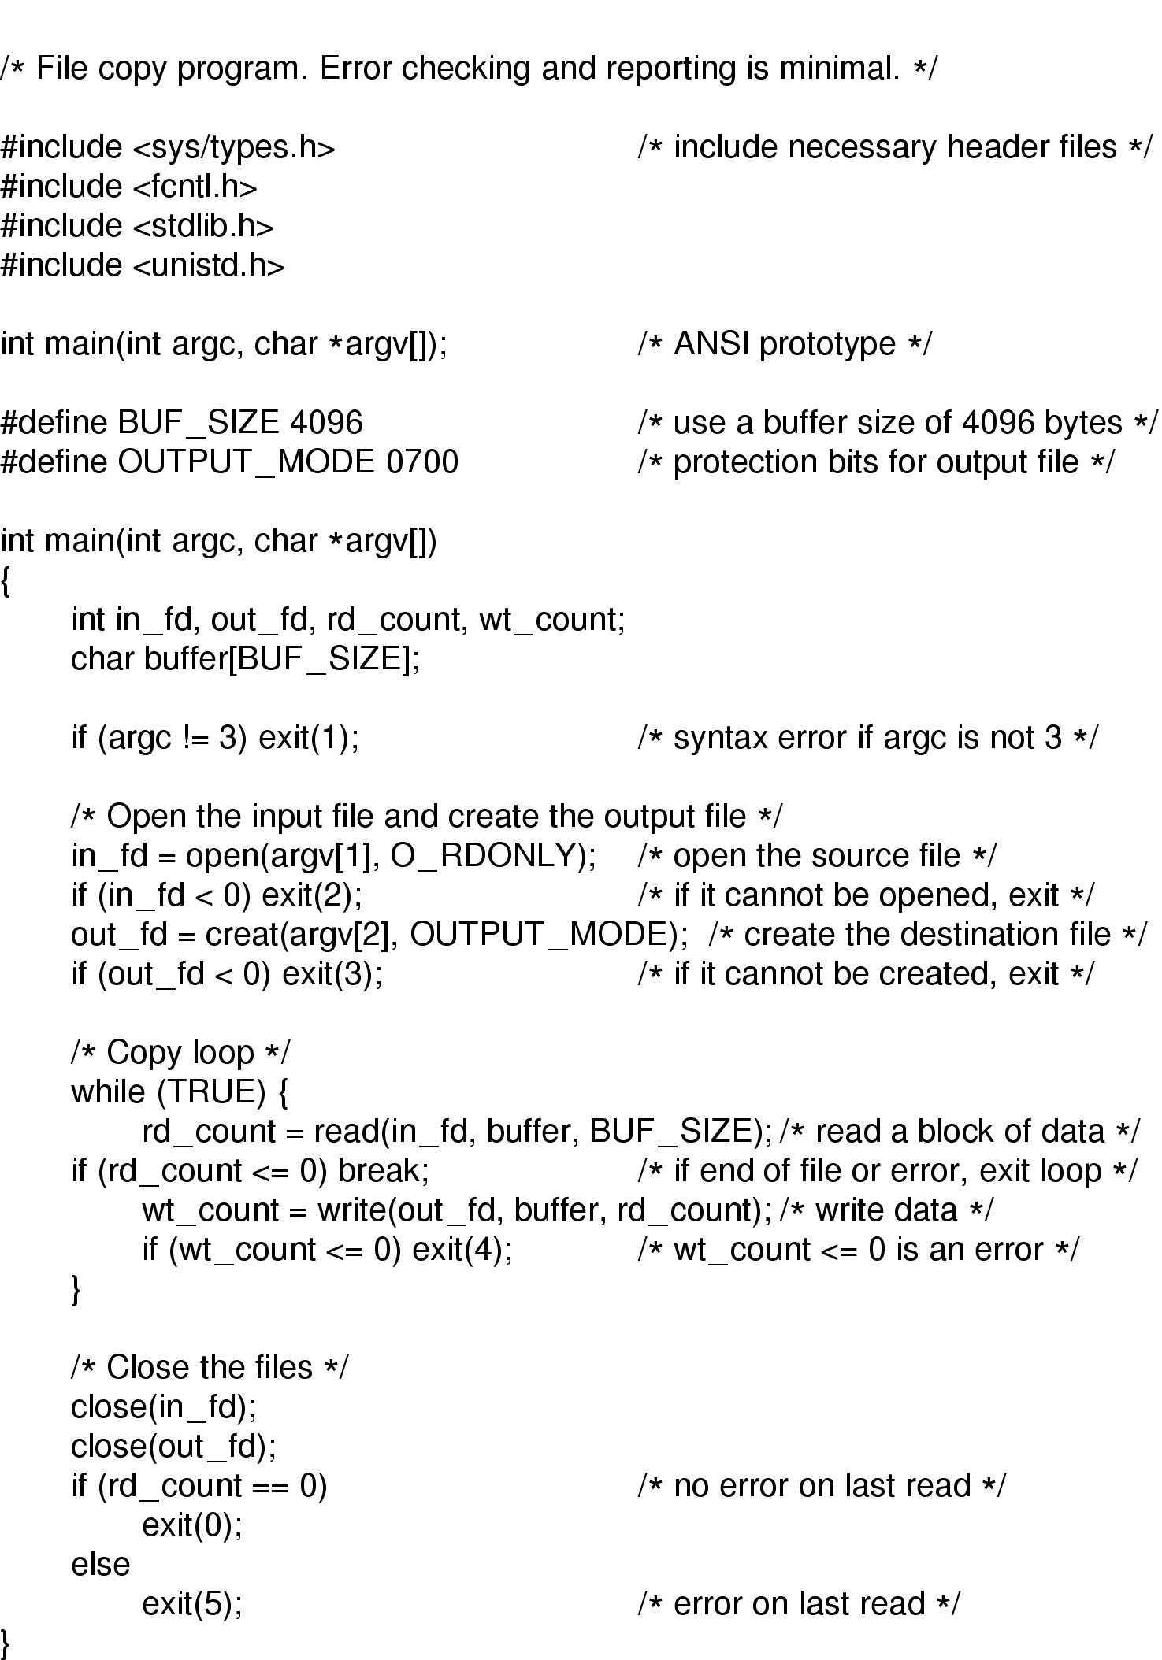
An Example Program Using File System Calls (1/2)

Slide 10
An Example Program Using File System Calls (2/2)

Slide 11
Alternative Interface: Memory-Mapped Files
Traditional file interface through system calls
  Open file
  Read data from file
  (Possibly) modify files
  Write data to file
  Close file
Would be nicer to:
  Map file into address space, starting at addr. X
  (possibly) modify elements of X
  Close file

Slide 12
Memory-Mapped Files, cont
Use virtual memory:
  Provide familiar load/store access to files
  Instead of read/write
  Use file itself as backing store (no swapfile)
  On close, file implicitly written to disk
Advantages:
  Less cumbersome, eliminate a copy
Disadvantages:
  What about large files, synchronizations, sharing?
UNIX provides this: mmap(fileId, virtAddr)

Slide 13
File Types
Regular files
  ASCII or binary
    Executable file (binary) have headers with:
    Magic #, text size, data size, etc..
Directories
Character/Block special files

Slide 14
Directories (user interface)
Generally, tree-structured
Consist of 0 or more files
Operations:
  Create, delete, open, close, read, list
  Link
    Same file in multiple directories
  Unlink
    Remove a directory entry

Slide 15
Organize the Directory (Logically) to Obtain
Efficiency – locating a file quickly.
Naming – convenient to users.
  Two users can have same name for different files.
  The same file can have several different names.
Grouping – logical grouping of files by properties, (e.g., all Java programs, all games, …)

Slide 16
Types of File Access
Sequential access
  read all bytes/records from the beginning
  cannot jump around, could rewind or back up
  convenient when medium was magnetic tape
Direct access (random access)
  bytes/records read in any order
  essential for data base systems
  read can be …
    move file marker (seek), then read or …
    read and then move file marker
Content-based access
  “find a certain type of data, e.g. person under 25 years old; this is really a database search

Slide 17
How are files typically used?
Most files are small (for example .login, .c files)
Large files use up most of the disk space
  Ex: image processing, multimedia
Large files account for most of the bytes transferred to/from disk
Bad News: need everything to be efficient
  Need small files to be efficient, since lots of them
  Need large files to be efficient, since most of the disk space, most of the I/O due to them

Slide 18
File System Implementation
Need to decide
  How to translate between user and system view
  How to store file on disk
  How system accesses file on disk
  How to manage disk spaces

Slide 19
Some Attributes of Open Files
Offset
Protection bits
File size
Modification times
Pointers to disk blocks
Open count
Cache

Slide 20
Translating Between User and System (single-process OS only)
Example:
  fileId = Open (“foo”);
  Read(buf, nbytes, filedId);
Open creates new openfile table entry
On read, fileId indexes into openfile table
Openfile table contains:
  Everything on last slides

Slide 21
Translating Between User and System (multiprogrammed OS)
Same interface
  Open, followed by Read
More complicated implementation
  Need to worry about files sharing
  UNIX
    File descriptor points to system-wide table
    System wide-table contains offset, protection, pointer to “I-node”
    I-node contains pointers to blocks, file size, etc.

Slide 22

In-Memory File System Structures

Slide 23
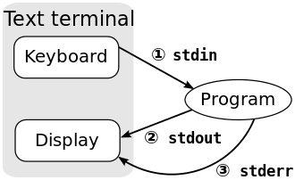
File Descriptor
a file descriptor is an index for an entry in an open file table.
There are three standard file descriptors, which every process should expect to have:
  0, stdin, standard input
  1, stdout, standard output
  2, stderr, standard error
Src: wikipedia

Slide 24
How is file stored?
Contiguous allocation
Linked allocation
  Couple variation
Indexed allocation
  Many variation

Slide 25
Contiguous Allocation
User must give file size in advance
Find free space on disk using first fit/best fit
Advantages
  Fast sequential access
  Fast random (direct) access
Disadvantages
  External fragmentation
  Hard to increase file size (moving it very expensive)

Slide 26

Contiguous Allocation

Slide 27
Linked Allocation
Hard to increase file size with contiguous
So, use linked blocks
  Each block contains pointer to next block
  Allows blocks to reside anywhere on disk
  This is main advantage – can increase file size
However
  Sequential access: seek between each block
  Direct access: horrible
  Unreliable (lose block, lose rest of file)

Slide 28

Linked Allocation

Slide 29

File-Allocation Table

Slide 30
FAT (File Allocation Table)
Used in MS-DOS
Basically an offshoot of linked allocation
  Keep the linked list in a separate part of the disk
    Read FAT into memory (or cache it)
    Find block by traversing FAT
    Then go get it on disk
  Reduces number of disk reads

Slide 31
Indexed Allocation
Still want to put free block anywhere on disk
Bring together all pointers into one block
  “index block”
  File creation: set pointers to NULL
  On write, find free block on disk, set pointer
  Direct access: read index block, find right block
    Similar mechanism to paging

Slide 32

Example of Indexed Allocation

Slide 33
Index Block Problems
How big should index block be?
  Too large =>waste space for small files
  Too small => painful when gets too large
Options for large files
  Link index blocks
  Multilevel index
    Read bunch of index blocks, then get data
    Bad for small files
  Combined scheme

Slide 34
Combined Scheme (UNIX)
Keep some pointers to disk blocks
Keep a few indirect pointers to index blocks
Example (UNIX 4.2)
  I-node contains 15 pointers
    12 to disk blocks (data)
    1 each to single, double, triple indirect block
  Relatively simple, extensible, small files good
  Large files: takes many read

Slide 35

Combined Scheme: UNIX (4K bytes per block)

Slide 36
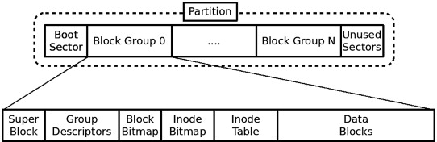
File Structures in Linux Ext4
Improved management of large files and offered more flexibility
Support volumes with sizes up to 1 exbibyte (EiB) and single files with sizes up to 16 tebibytes (TiB) with the standard 4 KiB block size.

Slide 37
File Structures in Ext4
Boot sector
  Block is a disk allocation unit of at least 512 bytes
  Contains the bootstrap code
  UNIX/Linux computer has only one boot block, located on the main hard disk

Slide 38
File Structures in Ext4
Superblock
  Indicates disk geometry, available space, and location of the first inode
  Manages the file system
Inode blocks
  Contain file and directory metadata
  Also link data stored in data blocks
Data blocks
  Where directories and files are stored
  This location is linked directly to inodes

Slide 39
Extents (EXT4)
Instead of represent each block, represent large contiguous chunks of blocks with an extent
An extent is a range of contiguous physical blocks, improving large-file performance and reducing fragmentation. A single extent in ext4 can map up to 128 MiB of contiguous space with a 4 KiB block size.
There can be four extents stored directly in the inode. When there are more than four extents to a file, the rest of the extents are indexed in a tree.

Slide 40
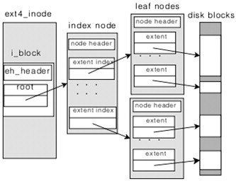

Slide 41
Directories
Directory: a relation used for naming
  Just a table of (file name, inumber) pairs
How are directories constructed?
  Directories often stored in files
    Reuse of existing mechanism
    Directory named by inode/inumber like other files
  Needs to be quickly searchable
    Options: Simple list, Hashtable, or B-tree
    Can be cached into memory in easier form to search
How are directories modified?
  Originally, direct read/write of special file
  System calls for manipulation: mkdir, rmdir
  Ties to file creation/destruction
    On creating a file by name, new inode grabbed and associated with new file in particular directory

Slide 42
Directory Organization
Directories organized into a hierarchical structure
  Seems standard, but in early 70’s it wasn’t
  Permits much easier organization of data structures
Entries in directory can be either files or directories

Slide 43

Not really a hierarchy!
  Many systems allow directory structure to be organized as an acyclic graph or even a (potentially) cyclic graph
  Hard Links: different names for the same file
    Multiple directory entries point at the same file
  Soft Links: “shortcut” pointers to other files
    Implemented by storing the logical name of actual file
Name Resolution: The process of converting a logical name into a physical resource (like a file)
  Traverse succession of directories until reach target file

Slide 44
Directory Structure (Con’t)
How many disk accesses to resolve “/my/book/count”?
  Read in file header for root (fixed spot on disk)
  Read in first data bock for root
    Table of file name/index pairs. Search linearly – ok since directories typically very small
  Read in file header for “my”
  Read in first data block for “my”; search for “book”
  Read in file header for “book”
  Read in first data block for “book”; search for “count”
  Read in file header for “count”
Current working directory: Per-address-space pointer to a directory (inode) used for resolving file names
  Allows user to specify relative filename instead of absolute path (say CWD=“/my/book” can resolve “count”)

Slide 45
File System Caching
Key Idea: Exploit locality by caching data in memory
  Name translations: Mapping from paths→inodes
  Disk blocks: Mapping from block address→disk content
Buffer Cache: Memory used to cache kernel resources, including disk blocks and name translations
  Can contain “dirty” blocks (blocks not yet on disk)
Replacement policy? LRU
  Can afford overhead of timestamps for each disk block
  Advantages:
    Works very well for name translation
    Works well in general as long as memory is big enough to accommodate a host’s working set of files.
  Disadvantages:
    Fails when some application scans through file system, thereby flushing the cache with data used only once
Other Replacement Policies?
  Some systems allow applications to request other policies
  Example, ‘Use Once’:
    File system can discard blocks as soon as they are used

Slide 46
File System Caching (con’t)
Cache Size: How much memory should the OS allocate to the buffer cache vs virtual memory?
  Too much memory to the file system cache ⇒ won’t be able to run many applications at once
  Too little memory to file system cache ⇒ many applications may run slowly (disk caching not effective)
  Solution: adjust boundary dynamically so that the disk access rates for paging and file access are balanced
Read Ahead Prefetching: fetch sequential blocks early
  Key Idea: exploit fact that most common file access is sequential by prefetching subsequent disk blocks ahead of current read request (if they are not already in memory)
  How much to prefetch?
    Too many imposes delays on requests by other applications
    Too few causes many seeks (and rotational delays) among concurrent file requests

Slide 47
File System Caching (con’t)
Delayed Writes: Writes to files not immediately sent out to disk
  Instead, write() copies data from user space buffer to kernel buffer (in cache)
    Enabled by presence of buffer cache: can leave written file blocks in cache for a while
    If some other application tries to read data before written to disk, file system will read from cache
  Flushed to disk periodically (e.g. in UNIX, every 30 sec)
  Advantages:
    Disk scheduler can efficiently order lots of requests
    Disk allocation algorithm can be run with correct size value for a file
    Some files need never get written to disk! (e..g temporary scratch files written /tmp often don’t exist for 30 sec)
  Disadvantages
    What if system crashes before file has been written out?
    Worse yet, what if system crashes before a directory file has been written out? (lose pointer to inode!)

Slide 48
What about crashes?
Better reliability through use of log
  All changes are treated as transactions.
    A transaction either happens completely or not at all
  A transaction is committed once it is written to the log
    Data forced to disk for reliability
    Process can be accelerated with NVRAM
  Although File system may not be updated immediately, data preserved in the log

Slide 49
Other ways to make file system durable?
Disk blocks contain Reed-Solomon error correcting codes (ECC) to deal with small defects in disk drive
  Can allow recovery of data from small media defects
Make sure writes survive in short term
  Either abandon delayed writes or
  use special, battery-backed RAM (called non-volatile RAM or NVRAM) for dirty blocks in buffer cache.
Make sure that data survives in long term
  Need to replicate! More than one copy of data!
  Important element: independence of failure
    Could put copies on one disk, but if disk head fails…
    Could put copies on different disks, but if server fails…
    Could put copies on different servers, but if building is struck by lightning….
    Could put copies on servers in different continents…

Slide 50
Free-Space Management
File system maintains free-space list to track available blocks/clusters
  (Using term “block” for simplicity)
Bit vector or bit map (n blocks)
0
1
2
n-1
…
1 ⇒ block[i] free
0 ⇒ block[i] occupied
bit[i] =

Block number calculation
(number of bits per word) *
(number of 0-value words) +
offset of first 1 bit
CPUs have instructions to return offset within word of first “1” bit

Slide 51
Free-Space Management (Cont.)
Bit map requires extra space
  Example:
block size = 4KB = 2¹² bytes
disk size = 2⁴⁰ bytes (1 terabyte)
n = 2⁴⁰/2¹² = 2²⁸ bits (or 32MB)
if clusters of 4 blocks -> 8MB of memory
Easy to get contiguous files

Slide 52

Linked Free Space List on Disk
Linked list (free list)
  Cannot get contiguous space easily
  No waste of space
  No need to traverse the entire list (if # free blocks recorded)

Slide 53
Free-Space Management (Cont.)
Grouping
  Modify linked list to store address of next n-1 free blocks in first free block, plus a pointer to next block that contains free-block-pointers (like this one)
Counting
  Because space is frequently contiguously used and freed, with contiguous-allocation allocation, extents, or clustering
    Keep address of first free block and count of following free blocks
    Free space list then has entries containing addresses and counts

